Slide 1
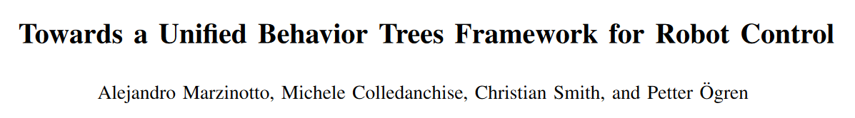
IEEE International Conference on Robotics and Automation (ICRA)
2014

Slide 2
Contributions
A more accurate and compact BT framework.
2) Introduction of the Action and Condition subsets.
3) Formalization and motivation of two node extensions.
4) Equivalence notions between BTs and CHDSs.

Slide 3
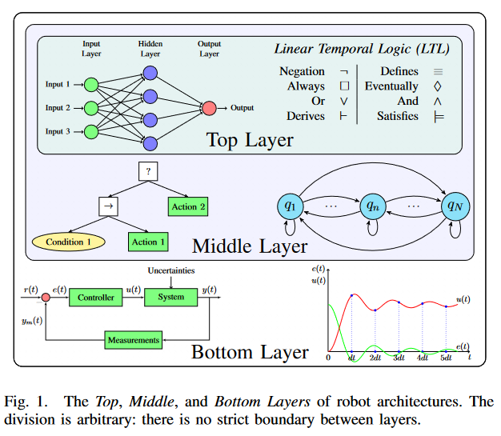
Robot Architectures

Slide 4
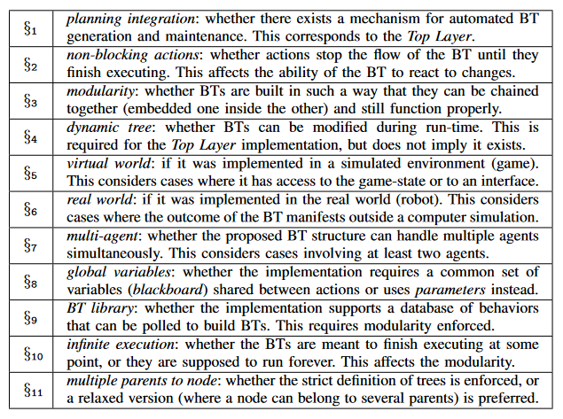

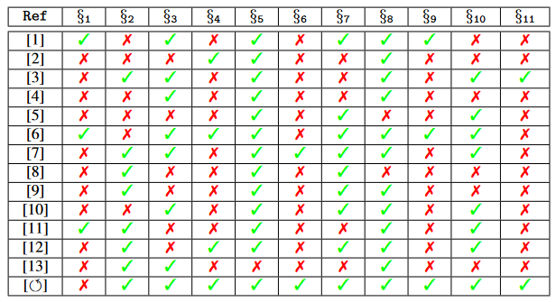

BT Framework
The available literature lacks the consistency and mathematical rigor required for robotic and control applications.
builds upon [13], [19] and [20]

Slide 5
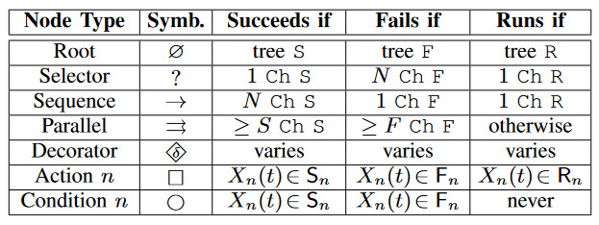
Node Types
S, F, R ⊆ X , Success/Failure/Running subsets
X(t) ∈ X , state space
U (t) ∈ U , control signals respectively

Slide 6
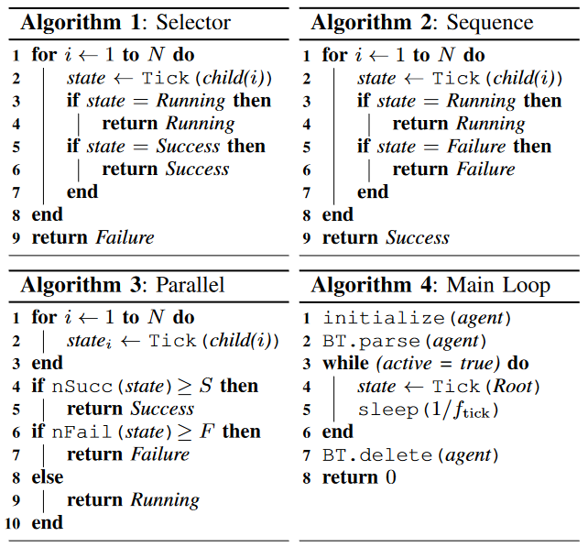
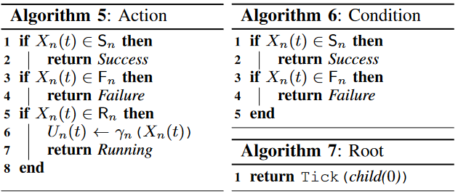
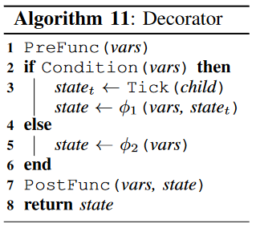

Slide 7
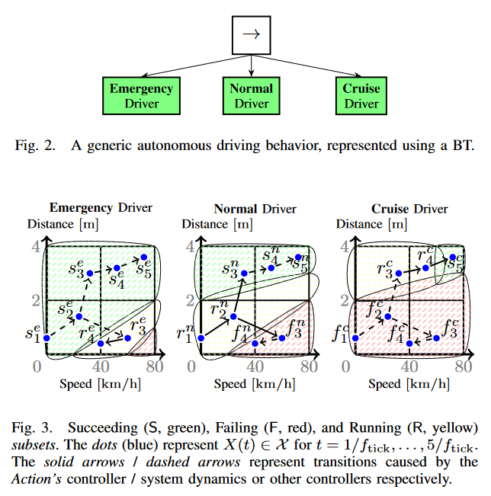
Action Subsets
Notes:
这张没看懂

Slide 8
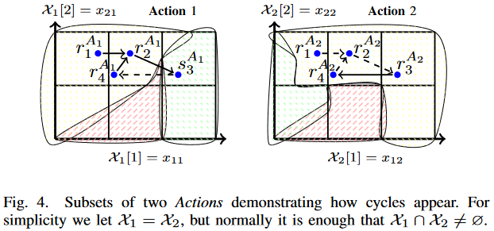
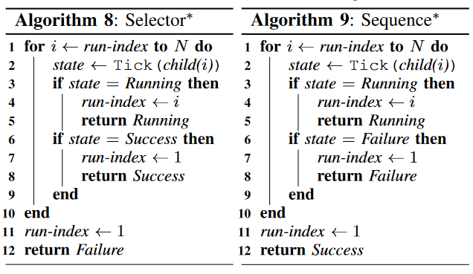
Node* Extensions

Slide 9
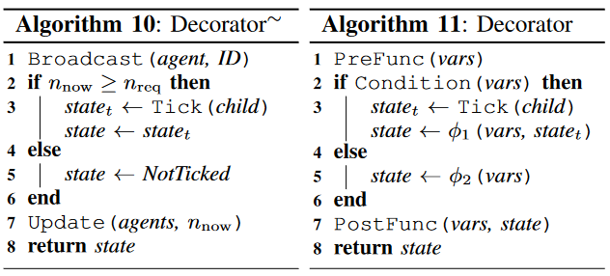
Decorator∼ Extension
two or more agents must undertake a common task Jointly by synchronizing parts of their BTs
Equivalence notions between
BTs and CHDSs
Notes:
一个大行为树控制两个智能体
分别控制（新的控制流节点，装饰器节点）

Slide 10
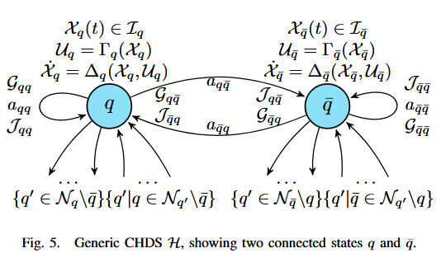
Equivalence notions between
BTs and CHDSs

Slide 11
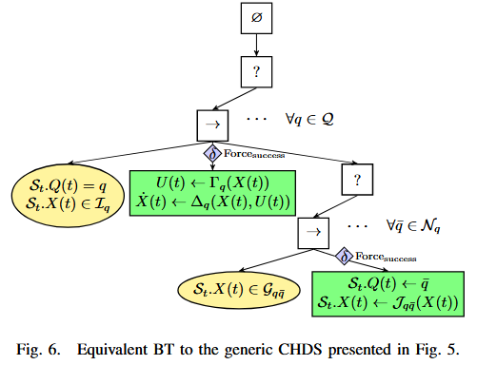
From CHDSs To BTs

Slide 12
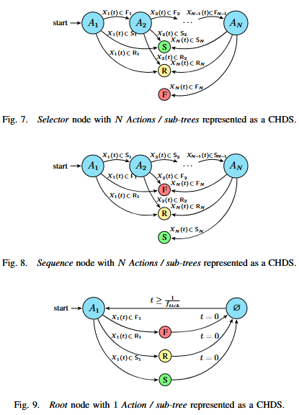
From BTs To CHDSs

Slide 13
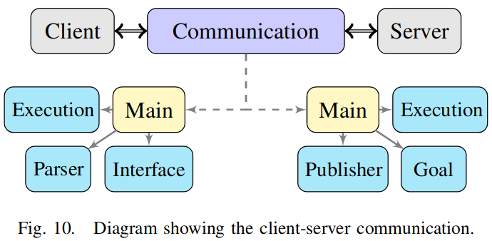
ROS Implementation
DoneCB called upon goal completion.
ActiveCB called upon goal acceptance.
FeedbackCB called upon feedback publishing.
GoalCB called upon new goal reception.
PreemptCB called upon goal preemption. ExecuteCB called periodically if the node is active.
Notes:
客户端：解析+接口+执行
Parser: Reads the BT specification from a file and generates the node objects dynamically.
Interface: Displays the BT with the node states in real-time
Execution: Generates a tick with a fixed frequency. Send an actionlib message to signal the server.
服务端：
Goal: Receives the actionlib messages,
determines if the control algorithms should be: started, resumed, or stopped
Publisher: send state updates to the client side, so that the BT node states are kept synchronized with the actual state of the controllers.
Execution: Runs the main loop of the controller.

Slide 14
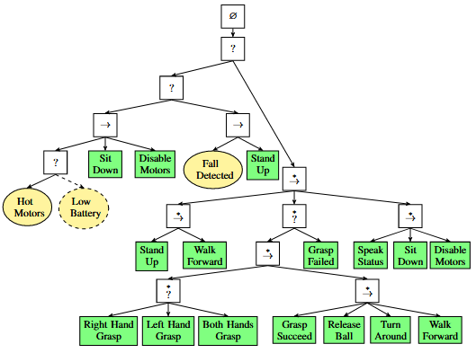
System Demonstration

Slide 15
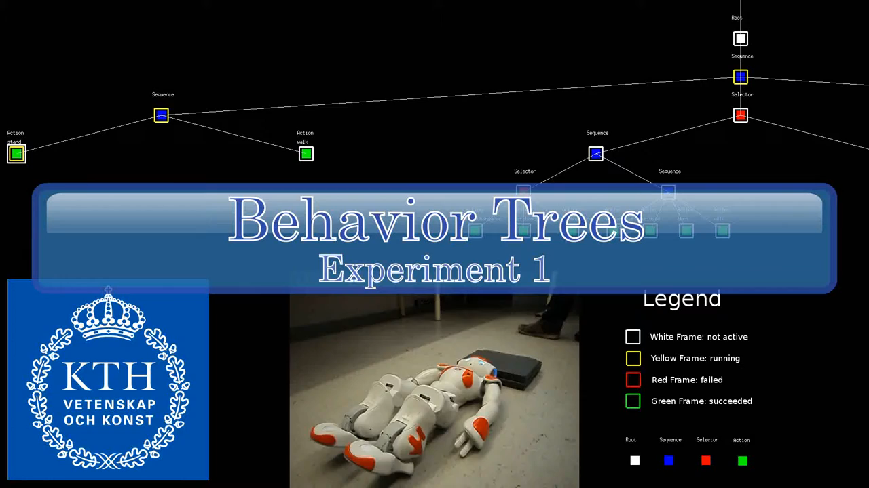

Slide 16
THANK YOU

